Slide 2

Oracle Secure Backup: Integration Best Practices With Engineered Systems
Donna Cooksey, Oracle, Principal Product Manager
Sam Corso, Oracle, Architect

Slide 3
Program Agenda
Oracle Secure Backup Overview
Optimized for Oracle Engineered Systems
Customer Success Stories
Sizing Your Tape Backup Environment
Customer Success Story – Oracle Cloud Services IT
Summary and Q & A

Slide 4
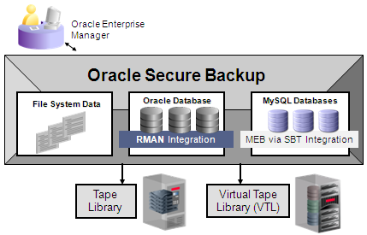
Oracle Secure Backup (OSB)
Centralized Tape Backup Management
Protects Entire IT Environment
Oracle Database 11g Release 2 to Oracle9i
25 – 40% faster tape backup
MySQL 3.6
Heterogeneous file systems (UNIX/ Linux / Windows) and NAS devices
Built-in Oracle Integration
Centralized management in distributed environments
Over 75% less expensive than comparable products
RMAN – Oracle Recovery Manager, MEB – MySQL Enterprise Backup, SBT – Oracle’s API for integration with media managers

Slide 5


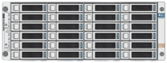
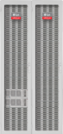


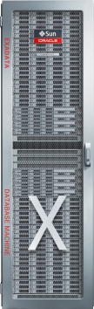

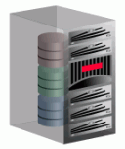
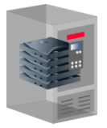
Centralized Tape Backup Management
Oracle Secure Backup
NAS
Oracle Database Appliance
Clients
Administrative Server
UNIX / Linux / Windows
LAN
Client / Server Architecture
Data protection for heterogeneous, distributed servers managed from a central console, Administrative Server
Media servers may be direct or SAN-attached to tape devices
OSB communicates directly with the client host to backup mounted file systems and storage
Oracle and MySQL databases may be located on any host within the backup domain as supported by the database
Storage
Media Server(s)
Exadata
Virtual Tape Library (VTL)
InfiniBand
Tape Library
Fibre

Slide 6
IT Challenges
Addressed With Oracle Secure Backup
IT Data Protection: CHALLENGES
Oracle Secure Backup: CAPABILITIES
Secure, unified data protection management:
Oracle database
File systems
Fast; meeting backup windows
Ease of management between system administration and DBA
Scalable meeting growing infrastructure requirements
Effective media management between multiple locations and/or tape copies
Maximize device utilization: keep the tape drives spinning!
Reduce IT infrastructure costs
Reliable backup and restore
Tightly integrated with RMAN achieving fastest tape backup by eliminating read and backup of
Unused database blocks
Committed undo
Heterogeneous file system and NAS support with policy-based backup management insuring consistency across the backup domain
Backup encryption and key management
Automated tape vaulting and duplication - RMAN RESTORE PREVIEW RECALL
Dynamic drive sharing
Compact catalog growth
Integrated with Oracle Enterprise Manager(EM)
Low-cost, single-component licensing saves money and simplifies license management

Slide 7
Enterprise-Class Features
Oracle Secure Backup Delivers….
Comprehensive media lifecycle management
Tapes managed from first write to reuse per user-defined policies
Automates tape duplication and vaulting
Advanced tape device configurations
Dynamic drive sharing between multiple media servers
Server-less tape duplication
Backup encryption and key management
Leverages host-based or tape drive (LTO or T10000) encryption
Keys generated and managed per user-defined policies

Slide 8

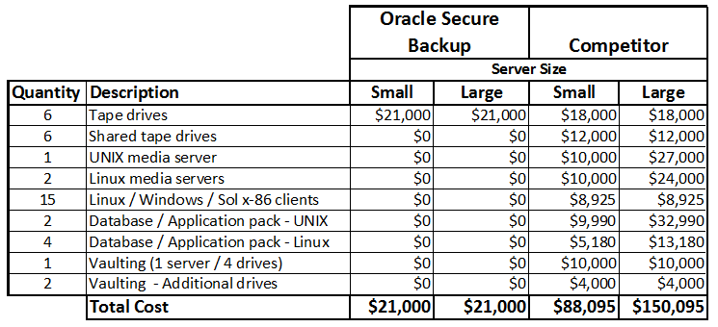
IT Cost Savings…75+ %
Migration to OSB
Oracle Secure Backup is licensed at $3500 per tape drive!

Slide 9
Broad Tape Device Support
Physical and Virtual Devices
ADIC | Copan Systems | Data Domain
Dell | EMC | FalconStor
HP | IBM | Overland Storage
Quantum | Qualstar | Sepaton
Sony | Spectra Logic | StorageTek
For a list of supported devices refer to:
http://www.oracle.com/technetwork/products/secure-backup/learnmore/osb-tapedevicematrix-520156.pdf

Slide 10

Optimized for Oracle Engineered Systems

Slide 11
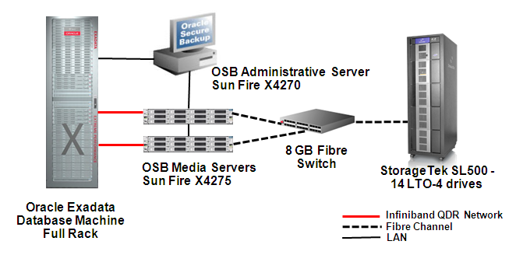
Complete Oracle Integrated Solution
Oracle Built, Supported and MAA Validated
Test Environment
Performance results:
Backup rate: 8.6 TB/hr 179 MB/sec per tape drive
Restore rate: 7.8 TB/hr 162 MB/sec per tape drive
8 Gb Fibre Switch
For more information, refer to the Maximum Availability Architecture (MAA) white paper : http://www.oracle.com/technetwork/database/features/availability/maa-tech-wp-sundbm-backup-final-129256.pdf
OSB / Exadata Datasheet: http://www.oracle.com/technetwork/database/secure-backup/learnmore/osb-103-dbmachine-datasheet-166807.pdf

Slide 12
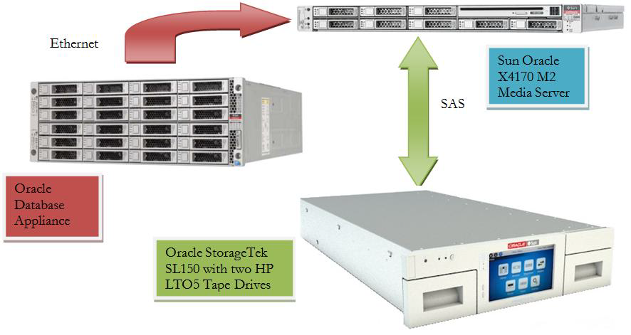
Oracle Database Appliance
Oracle Secure Backup Achieves 268MB / Sec Rate Per LTO-5 Drive
Oracle Secure Backup Administrative / Media Server
OSB Backup Performance
Tape Drive | Interface | Sustained Backup Rate Per Drive
LTO-5* | 10GgE | 268MB /sec
LTO-5** | GbE | 55MB /sec
*LTO-5 native throughput 140 MBs with up to 2:1 tape drive compression
** The limiting factor in the GbE results was saturation of interface bandwidth as an active-active and/or more NICs or media servers would have achieved better rates.
For more information refer to:
http://www.oracle.com/technetwork/server-storage/engineered-systems/database-appliance/documentation/protecting-oda-with-osb-1674207.pdf

Slide 13
Optimized for Oracle Environments
Oracle Secure Backup
Built-in Integration with Recovery Manager (RMAN) API and beyond:
RMAN backup encryption
Unused block and undo block compression
Shared tape buffers with RMAN
Ideally suited for Oracle environments with infrastructure performance optimizations:
NUMA-aware for Oracle database shadow processes
RDS / RDMA* support and transport over InfiniBand networks
*Reliable Datagram Socket over Remote Direct Memory Access
Notes:
The Oracle database shadow backup/restore process and OSB data service communicate via a shared memory area for data transfer between the processes. On NUMA (Non-Uniform Memory Access) machines, OSB 10.4 insures these corresponding processes run in the same NUMA region(s) to deliver the fastest performance. If Oracle database shadow processes are spread over multiple NUMA regions for load balancing, OSB piggy backs on this distribution to always align processes within the same NUMA regions.
Oracle Secure Backup 10.4 leverages RDS / RDMA over Infiniband (IB), thereby increasing data transfer rates over the IB port on the media server providing two key advantages:
Potentially reduces the number of media servers required to meet performance goals as more front-end throughput allows more tape drives per media server to be effectively utilized. If throughput is around 50% higher using RDS / RDMA over IB, that would translate to about 3GB/sec instead of 2GB/sec per media server with one IB port.
Media server(s) could leverage multiple IB ports versus only one when using TCP/IP over Infiniband as adapter bonding does not support TCP/IP over IB at this time – only RDS / RDMA. Two IB RDMA ports per media server could effectively double the front-end throughput.
Oracle Secure Backup 10.4 balances the load across like network interfaces thereby increasing performance and avoiding over / under use of any one interface. If a host contains more than one network interface of a particular type, OSB uses all the available interfaces of that type for the data connections between the client host and the media server host. The type of network interface will be selected by OSB in priority order of RDS / RDMA (Reliable Datagram Socket over Remote Direct Memory Access) over Infiniband, IPv6 and then IPv4.
The connection type must be supported on both the client and the media server for it to be selected by OSB. If RDS / RDMA over Infiniband isn’t supported on both hosts, Oracle Secure Backup will automatically use TCP/IP over Infiniband. If an OSB Preferred Network Interface (PNI) is configured, then load balancing on the media server will be disabled in favor of the user-defined PNI setting.

Slide 14
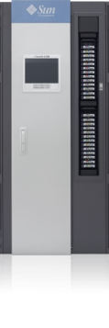
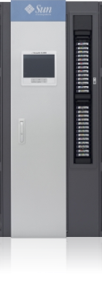

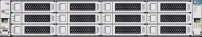
OSB – Backup Over InfiniBand (IB) Network
More Throughput is a Good Thing!
The Way It Was…
OSB 10.4 – The Way It Is…
TCP / IP over InfiniBand
RDS / RDMA over InfiniBand
~50% more throughput per port
Fewer media servers needed
SAN
SAN
Media Servers
Media Server
…~2 GB/s throughput !
…~3 GB/s throughput !
Limit of one port per media server
Supports more than one IB port per media server
TCP / IP over IB
Fibre
RDS/RDMA over IB
Fibre
Notes:
Oracle Secure Backup 10.4 leverages RDS / RDMA over Infiniband (IB), thereby increasing data transfer rates over the IB port on the media server providing two key advantages:
Potentially reduces the number of media servers required to meet performance goals as more front-end throughput allows more tape drives per media server to be effectively utilized. If throughput is around 50% higher using RDS / RDMA over IB, that would translate to about 3GB/sec instead of 2GB/sec per media server with one IB port.
Media server(s) could leverage multiple IB ports versus only one when using TCP/IP over Infiniband as adapter bonding does not support TCP/IP over IB at this time – only RDS / RDMA. Two IB RDMA ports per media server could effectively double the front-end throughput.

Slide 15
OSB Supports Multiple Networking Protocols
Oracle Secure Backup uses protocols in this order of preference:
RDS / RDMA over IB, TCP / IP over IB or GbE - IPv6 or IPv4
RDS is supported for Linux, Solaris, Solaris SPARC
By default, OSB will use RDS / RDMA over IB when both the client and media server both have IB interfaces
This may be changed at the domain level via operations policy or at the host level
Configure OSB Preferred Network Interface (PNI) to direct backup data traffic over the desired interface

Slide 16
OSB – Backup to High-Performance Drives
Do You Want Fast or REALLY Fast?
OSB delivers REALLY fast backup to high performance drives:
StorageTek T10000C: 350MB/s +
LTO-5: 268MB/s
OSB 10.4.0.2 improves backup performance using asynchronous I/O
Leverages write command queuing for SCSI commands
To enable async I/O on Linux media servers, enable direct I/O via:
# touch enable_dio in $OSB_HOME/device
# echo 1 >/proc/scsi/sg/allow_dio
Notes:
Starting with Oracle Secure Backup 10.4.0.2.0, you can choose to improve the write throughput of your tape devices by using asynchronous I/O. Asynchronous I/O implements write command queuing for SCSI channel operations. In this release, the LT05 and T10000C tape drives take advantage of the performance benefits provided by asynchronous I/O. This functionality is supported on Linux platforms only.
To enable asynchronous I/O, direct I/O must be enabled on the Linux media server. Perform the following steps to enable direct I/O:
# touch enable_dio in $OSB_HOME/device # echo 1 >/proc/scsi/sg/allow_dio Ensure that the environment variable OSB_HOME is set to the location of Oracle Secure Backup home directory.
Note:
Support for asynchronous I/O is available only on Linux.

Slide 17
Complete Oracle Integrated Solution
OSB 10.4.0.2 and StorageTek T10000C Tape Drives
Test Environment
Performance results:
Backup rate: 9.6 TB/hr 350 MB/sec per tape drive
Restore rate: 8.5 TB/hr 309 MB/sec per tape drive
8 Gb Fibre Switch
StorageTek SL3000 – 8 T10000C drives

Slide 18
Customer Success Stories

Slide 19
Monsanto Company
COMPANY OVERVIEW
Industry: Bio-Technology/Agriculture Employees: ~22,000 Revenue: US$11.8 billion in FY 2011
Monsanto is a leading global provider of agricultural products that improve farm productivity and food quality. The company is committed to producing more, conserving more and Improving lives.
Double yields in our core crops by 2030
Use one-third fewer resources per unit of output
Improves lives of farmers all over the world
CHALLENGES / OPPORTUNITY
Putting better seeds into the hands of farmers faster will help them feed a growing world population. To produce these new products, we leverage innovative technologies such as biotechnology and molecular breeding, both information-intensive activities that require fast turnaround times and massive computing power. Harvest data collected from the fields must be processed quickly so scientists can make advancement decisions about potential products.
Researchers analyze huge volumes of data to determine which potential products have the right combination of traits for combating insects, controlling weeds, and increasing yield, while ensuring, quality, flavor, and nutrition of the resulting harvest.
CUSTOMER PERSPECTIVE
“We plan the harvest season for two or three times the load on our information systems. The Oracle Exadata systems contain Oracle hardware, Oracle software, and Oracle database technology, all integrated into a cohesive system. Working with a single vendor has made it a lot easier to resolve issues. There’s no question about responsibility or ownership if something goes wrong.”
“We were no longer comfortable with our ability to recover the entire database within a day’s time. Now, with the Sun ZFS Storage Appliance, if we have any type of data corruption issue, we can resolve it very quickly. ZFS provides a more accessible, faster solution”
SOLUTIONS
Exadata Database Machine X2-2
Oracle Real Application Clusters
Sun ZFS Storage Appliance
Oracle Secure Backup
Oracle Active Data Guard
Oracle WebLogic Server
Oracle Service Bus
Oracle Coherence
Oracle Managed Services
Website: http://www.monsanto.com/
Notes:
…
Talk about how

Slide 20
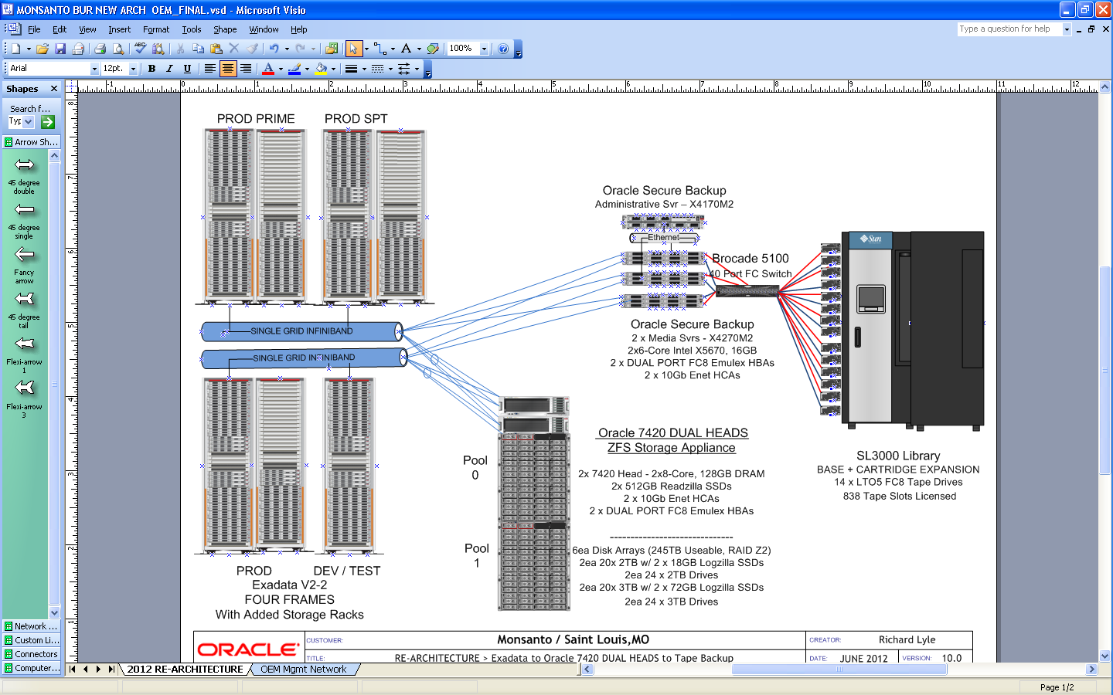
Monsanto Exadata Architecture

Slide 21
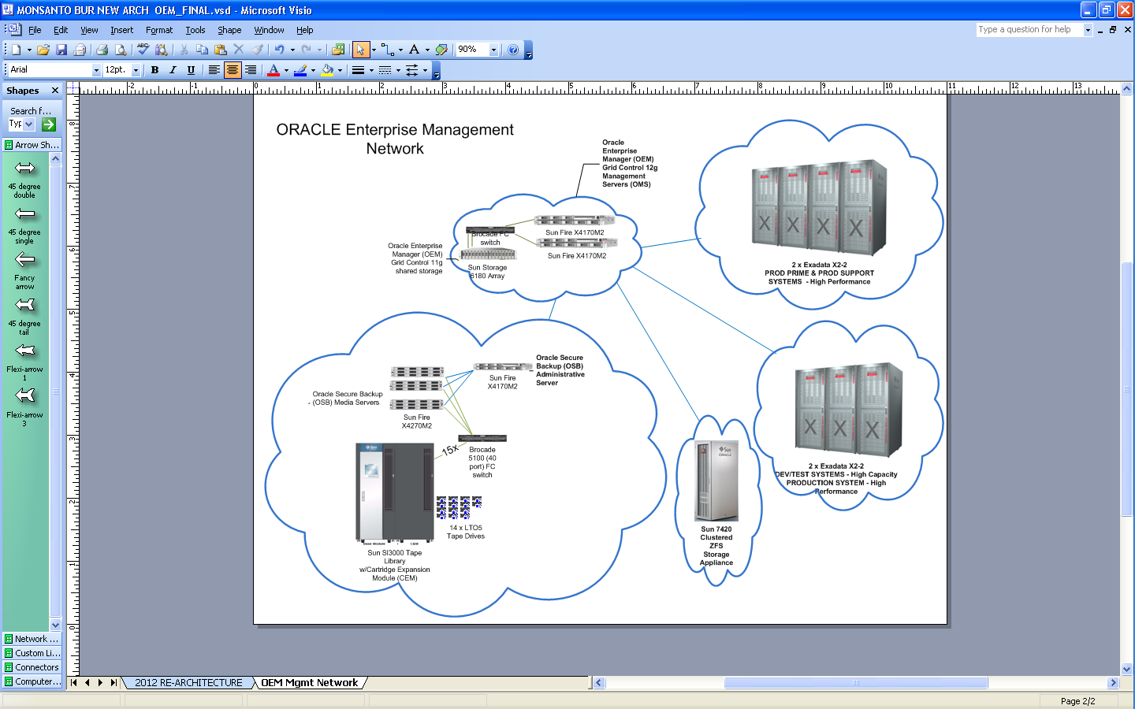
Monsanto – Exadata and Backup Cloud

Slide 22
Monsanto Exadata Transformation
Targeted Goals
Exadata Differentiator
Realized Benefits
Migrated over 80 business critical applications to Exadata Platform
Consolidation of 21 databases into single RAC and storage platform
Maintain 4 Production like environments with equal data size and similar outage, backup and recovery process
Reduced Support and Maintenance cost related to managing multiple platforms and Databases
Implementation of standard support process across all environments
Platform Consolidation
Efficient use of Maximum Availability Architecture
Proactive Monitoring and Reporting
Proactive patching
Onsite Exadata support staff
Predictive hardware failure and issues resolution
100% availability during Harvest season
99.95% availability during Non Harvest season
Reduced planned and unplanned outages by effectively using Standby
Zero impact to customer during component failure
High Availability / Zero Outage
RMAN compression algorithm changes and implementation of BUR best practices
Optimized use of ZFS storage
Enabled multi-level compression options based on application data.
Improved disk refresh process through continuous process improvements
Capacity management of disk backup for larger databases.
Over 40% improvements in tape backup performance
Improved ZFS disk refresh process (RTO of 8 hrs)
Reduced ZFS disk backup time from 11 to 4 hrs
Improved data backup and recovery
Notes:
20% increase in disk backup size.
Capacity management of backup
Point 2 -> Migrated 21 DB’s into single database
Point 1 -> 80 Business critical applications
4 equivalent environments – and equal amount of data in all environments..
Support equivalent across the environments – Service levels are met for PROD / Non PROD
7 TB – How this was released
35% DB Memory – What it was before and how much it came back..
All performance improvements – Questionable.. ? (examples to speak to)..
Improved data backup / recovery – 20% increase – how the performance improved. Time to backup decreased…
Refreshes of PROD / Non PROD – how ocms is bringing to the table..
Look @ Implementation around Max Avlblty architecture

Slide 23
Real-World Cost Savings
OSB Versus Competitor
Licensing | Oracle Secure Backup | Competitor | Comments
4 Exadata Full Racks | $ 0 | $ 14, 280 | 4 full racks x 8 nodes each = 24 clients
Administrative/Master Server | $ 0 | $ 5,000 | 1 Admin / media server
Media Servers | $ 0 | $ 16,500 | 3 media servers
Database modules | $ 0 | $ 40,680 | Database module (Tier 2) for each database node
Vaulting | $ 0 | $ 30,000 | 1 server and 14 tape drives
14 Tape Drives | $ 49,000 | $ 42,000
Shared Storage Option | $ 0 | $ 28,000 | Sharing of tape drives in SAN environment
Total | $ 49,000 | $ 176,460
Savings |  | $ 127, 460

Slide 24



Powered by ORACLE
Exadata & Oracle Secure Backup (OSB)
Working Together for Azkar
pedro.galan@azkar.com

Slide 25
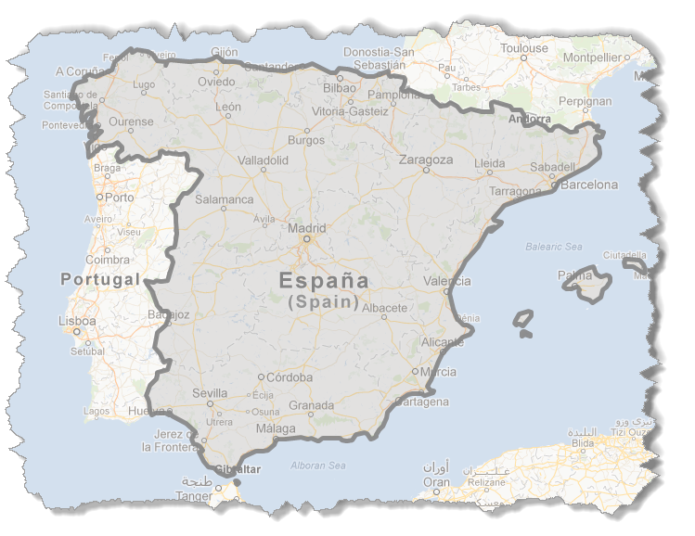

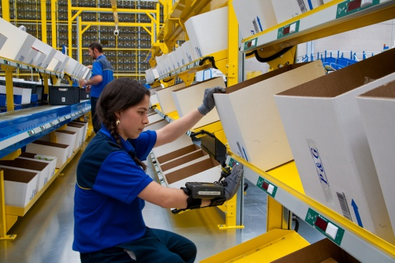

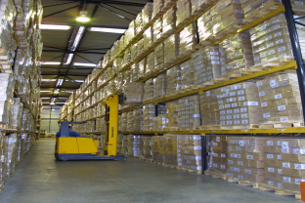


12.000.000 shipments / year
+ 3.000
Employees
1.500.000 transactions / day
91
Facilities
400 MM €
24 h company
Pick-up today → Delivery tomorrow
+2.500
Vehicles

Slide 26
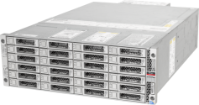
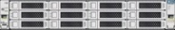

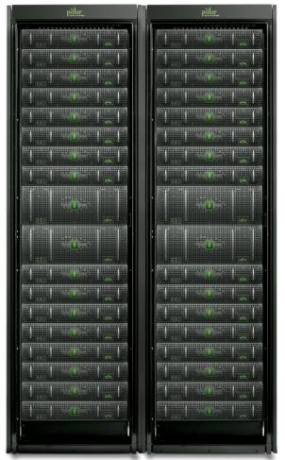
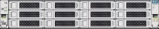
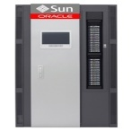
Architecture implemented
Exadata Architecture (1 x ¼ )
Ethernet
Exadata Production Enviroments SAP & no-SAP
ODA Contingency
Sun Fire x4170 Sislog Application
Fast Recovery Area (FRA)
Oracle Data Guard
Sun Fire x4170 SAP App.Servers
Sun Fire x4170 Pr
Quality
Development
enviroments
RMAN
(Different Location)
2 Critical DB replicated.
NFS over Infiniband QDR
OSB Admin/Media Server
Cloud Control
Storage Axiom Development & Quality
Storage Axiom Windows, VMware
Enterprise Manager
Tape Storage
SAN

Slide 27
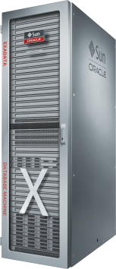
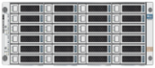

Exadata back-up enviroment
Data Guard
ODA
Oracle Secure Backup
Administrative / Media Server
Fast Recovery Area
Flashback logs
Control file autobackups
Archived logs
InfiniBand
QDR Network
Sun Fire x4270M2
Brocade 300 8Gb Switch
StorageTek SL500
w/ 4 LTO-5 drives
(7) Sun Fire x4170 Sun Solaris (3 fisical / 13 cont): SAP Oracle Linux (4): Oracle DB + Aplications

Slide 28

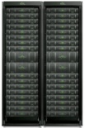
Exadata back-up strategy
ODA
Data Guard (different location)
RTO = 1h
RPO = “0”
FRA
RTO = 10 m
RPO = “0”
Fast Recovery Area: -Flashback logs
ASM
Archived logs
Daily Full back-up (to tape) and archived logs to DB in ASM Exadata
RTO = 2 h
RPO = 10 m
2 days in archived logs
Tape Storage
Full to tape
Daily Full back-up and archived logs to Axiom via NFS1
RTO = 2 h
RPO = 10 m
Axiom
7 days archived logs
For the rest of DB

Slide 29
DB running in Exadata → OSB
DB | Size (GB) | Time | GB / sec
PROBID | 1.278,4 | 1h 46’ 30” | 0,216
PROCTX | 4,6 | 6’ 27” | 0,012
PRODBO | 689,5 | 1h 23’ 24” | 0,138
PROILO | 19,3 | 7’ 28” | 0,043
PROIMG | 877,2 | 1h 43’ 32” | 0,141
PROLIQ | 12,3 | 8’ 2” | 0,009
PROMETA4 | 20,6 | 21’ 36” | 0,004
PROSMX | 217,6 | 1h 26’ 2” | 0,089
PROVIEW | 382,8 | 40’ 42” | 0,157
VCDB | 3,1 | 6’ 18” | 0,008
RMAN11 | 1 | 7’ 18” | 0,002
PROGEN | 15,1 | 6’ 46” | 0,037
PROBI | 160,8 | 19’ 49” | 0,135
Example
PROBID:
HP Data Protector = 7h
Back-up to disk = 5h
OSB Back-up to tape = 1h 46m

Slide 30

What has already been achived ?
Higher performance to deliver info to Customers (+New project Golden Gate)
Less time for internal business administrative operations.
> 65% on averadge.
(some procesess > 90%, from 8h to 1h)
Back-up process time improved by 75% with OSB
Invoicing and spent allocation, 8 h less (10h→2h)
Cost reduction in Capgemini provider running services

Slide 31
Sizing Your Backup Environment

Slide 32

Planning
Connectivity Speeds and Feeds
Exadata to Media Server
Per Tape Capacity and Speeds
Network Connectivity | Typical Network Bandwidth per Port
InifinBand QDR (40Gbps) | 2GB – 2.5GB/sec*
10 GigE | 1GB – 1.25GB/sec
1 GigE | 100MB – 125MB/sec
Tape Drive / Media | Native Capacity | Compressed Capacity | Native Speed | Typical Compressed Speed (1.5:1 ratio)
LTO4 | 800 GB | 1.6 TB | 120 MB/sec | 180 MB/sec
LTO5 | 1.5 TB | 3 TB | 140 MB/sec | 210 MB/sec
T10000C | 5 TB | 10 TB | 240 MB/sec | 360 MB/sec
Media Server
FC Connectivity | Typical Bandwidth per Port
2 Gb / sec | 200MB/sec – 212MB/sec
4 Gb / sec | 400MB/sec – 425MB/sec
8 Gb / sec | 800MB/sec – 850MB/sec
* 3GB/sec when using OSB 10.4 RDS/RDMA over IB

Slide 33
How Do I Calculate Available Throughput?
One Component at a Time!
Exadata to Media Server(s)
# database nodes |  | X | Estimated throughput per port
= | Total available throughput from Exadata to the media server(s)
Maximum Throughput Available
# of tape drives |  | X | estimated throughput per drive
= | Total possible throughput Assumes number of appropriate throughput from infrastructure (number of media servers, network bandwidth, etc.)
Media Server - Incoming
Media Server – To Tape
# of active network ports |  | X | estimated throughput per port
= | Available front-end throughput per media server
# of active HBAs |  | X | estimated throughput per port
= | Available back-end throughput per media server to tape drives

Slide 34
Plugging in The Numbers
Total Throughput as Fast as The Slowest Component
8 database nodes |  | X | 2 GB/sec IB links
= | 16 GB/sec throughput available
8 LTO-5 drives |  | X | 140 Mb/sec each
= | 1.1 GB/sec throughput available
3 Media Servers |  | X | 2 GB/sec IB links
= | 6 GB/sec front-end throughput available
32 LTO-5 drives |  | X | 140 Mb/sec each
= | 4.5 GB/sec throughput available
8 T10000C drives |  | X | 240 Mb/sec each
= | 1.9 GB/sec throughput available
Exadata Full Rack
3 Media Servers |  | X | 2 – 8 Gb HBAs
= | 4.8 GB/sec back-end throughput available (6 HBA ports * 800Mb/sec each)
StorageTek SL3000
19 T10000C drives |  | X | 240 Mb/sec each
= | 4.6 GB/sec throughput available
3 Media Servers, each has:
1 IB link and 2 - 8 Gb HBAs
Note: Assumes native throughput for tape drives

Slide 35
Scheduling Considerations
Database grows to 120 TB
Backup takes 15 hours
One 80 TB database
Backup takes 10 hours
Stagger backups to run sequentially
80 TB = 10 hours then
40 TB = 5 hours
Total backup time = 15 hours
Backup Throughput = 8 TB / hour
Two databases:
1 = 80 TB and 2 = 40 TB
Run backups concurrently
Backups complete in 15 hours although unpredictable as to when each completes
Tape environment - assign tape drives to each database (Assume 8 drives at 1TB/h each): 5 to DB 1 would complete in 16 hrs and 3 drives to DB 2 would complete in 13.3 hours
Two databases:
1 = 80 TB and 2 = 40 TB
Backup window = 5 hours
Purchase additional hardware increasing total backup throughput to 24 TB / hour
Notes:
If I have a tape library with 8 tape drives that can backup at 8TB/hr, and my database is 80TB in size, then the backup will run in 10 hours.
If my database doubles in size, but I still have 8 tape drives then the backup will run in 20 hours.
So if I consolidate two databases, one sizes 80TB and the other sized 40TB, and I have my 8 tape drives that can backup at 8TB/hr, my options are
I backup the first database starting at midnight and running until 10am, and then at 10am I backup the second database and this would run until 3pm
Alternatively, I could start both backups at midnight, and allocate 5 tape drives to the 80TB database, meaning the backup would now run in 16 hours, finishing at about 4pm, and the 40TB database gets 3 tape drives, meaning the backup would run in 13.3 hours finishing around 1:20pm.
Alternatively, I could start both backups at midnight, and let the 8 tape drives service the two databases (total 120TB), and while we would not know when each database would finish, both database will have finished by 3pm.
In order for both databases to finish by 10am, we would need to add 4 more tape drives (total 12 tape drives or 12TB/hr), and the backup of 120TB would then finish by 10am.

Slide 36
Customer Success Story: Oracle Cloud Services IT

Slide 37
Cloud Services IT
Backup and Recovery: High-level
Cloud Services IT provides backup and recovery of our hosted customers environments and supporting infrastructure
All tape backups in Cloud Services are run on Oracle Secure Backup
Standard and extended retention backups and recovery
Disaster Recovery shipping tape to customers
Site to site recovery, migration
Onsite archived log backups
File system , NDMP and RMAN based backup and recovery

Slide 38
Cloud Services IT
Backup and Recovery: Size
24 Oracle Secure Backup domains worldwide
6 data centers
Monthly backups: 13 PB+
Tape drives: 320+ LTO4/LTO5
Tape libraries: 13 x StorageTek SL3000
Tape managed: 20,000+

Slide 39
Oracle Secure Backup (OSB) 10.4.0.2
Oracle IT has Standardized on OSB: Key Points
On the fly device awareness, no daemons to restart after modifications
Multiple attach points used to provide media server fail over for tape drives
Robust networking allows for the most complex network deployments
Typical standard/base deployment: 3 Hosts
1 Admin
2 Media Servers (add more as you grow)
Media Servers are always deployed in pairs
Strong raw restore capability

Slide 40
Oracle Secure Backup (OSB) 10.4.0.2
Oracle IT has Standardized on OSB: Best Practices
Sizing per media server is variable, the media server has about 14Gb/s to use
Our ratios are usually around 8 to 10 tape drives per media server
Deploy media servers in pairs leveraging attach points
Use unique media families naming schema per domain
Align your write windows with your vaulting schedules
Size your throughput to your data
Standardize your blocking factor

Slide 41
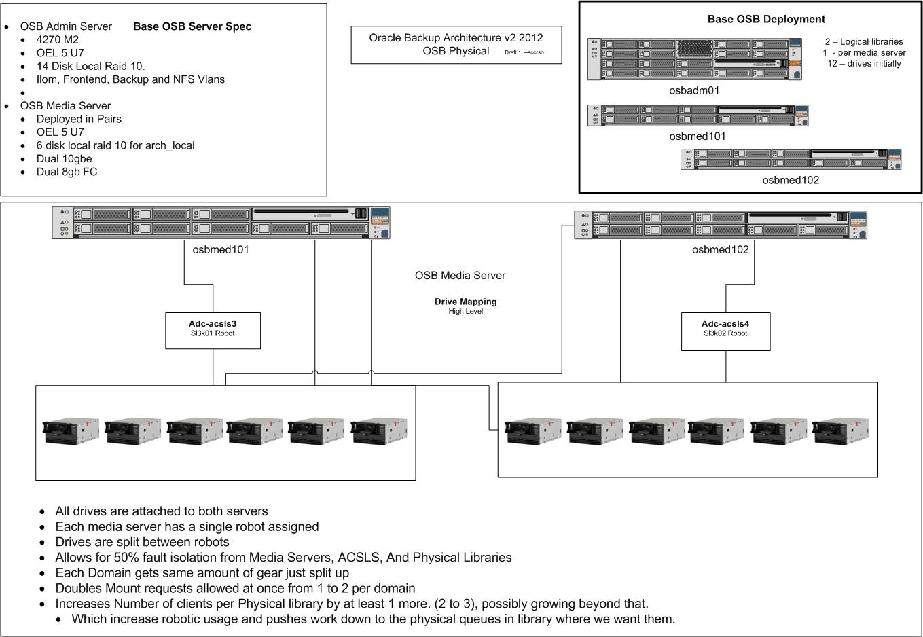
High Level End to End Cloud Zone
1. More then 1 Logical Library per OSB Domain
2. Even / Odd
Drives
ACSLS/Library
Servers
3. More then 1 OSB Domain per physical library
4. 50% Fault Isolation
5. Double the robotic moves at once
6. More Flexibility for growth

Slide 42
Summary and Q & A

Slide 43
Oracle Secure Backup
Built-In Oracle Integration
Oracle Secure Backup
Oracle Enterprise Manager (EM)
Recovery Manager (RMAN)
StorageTek Tape Devices
Oracle Exadata Database Machine
Oracle Storage and Servers
Oracle Database Appliance
Increased Return on Investment (ROI):
Single technical support resource from hardware to software
High-performance, secure tape backup – Exclusive optimizations
Fully validated component of the Oracle Maximum Availability Architecture (MAA)
Substantial cost savings – about 75% less than others
Who Better to Backup Oracle than Oracle?

Slide 44
Key Takeaways
Fast, Affordable and MAA Validated
Built-in Oracle integration
Fastest Oracle database backup to tape
Lowest-cost enterprise backup software
Optimized for Oracle Engineered Solutions!

Slide 45
Key HA Sessions and Demos by Oracle Development
Monday, 1 October – Moscone South
12:30p Oracle Data Guard Zero-Data-Loss Protection at Any Distance, 300
12:30p Future of Exadata: OLTP, Warehousing, and Consolidation, 104
1:45p Automating ILM with the Latest Database Technology, 300
1:45p Extracting Data in Oracle GoldenGate Integrated Capture Mode, 102
3:15p Maximize Availability with the Latest Database Technology, 303
3:15p Maximize Enterprise Availability with the Latest DB Technology, 303
4:45p Mission-Critical Oracle Exadata OLTP Deployment at PayPal, 300
4:45p Temporal Database Capabilities with the Latest DB Technology, 300
Tuesday, 2 October – Moscone South
10:15a Database Tables to Storage Bits: Data Protection Best Practices, 300
10:15a GoldenGate & Data Guard: Working Together Seamlessly, 305
11:45a Active Data Guard Zero-Downtime Database Maintenance, 300
11:45a Using Automatic Storage Mgmt with the Latest DB Technology, 301
1:15p The Four Ts of RMAN: Tips, Tuning, Troubleshooting, and … ?, 102
5:00p Maximum Availability Architecture Best Practices for Exadata, 303
Wednesday, 3 October – Moscone South
10:15a Operational Best Practices for Oracle Exadata, 102
10:15a Maximize Availability by Minimizing Disruption for End Users
and Application, 301
11:45a What’s New in the Latest Generation of Oracle RAC, 301
11:45a Best Practices for HA w/ GoldenGate on Oracle Exadata, 102
1:15p Oracle Secure Backup: Integration Best Practices with
Engineered Systems, 300
1:15p Application MAA Best Practices on Oracle Private Clouds, 200
5:00p Tuning &Troubleshooting Oracle GoldenGate on Oracle, 102
Thursday, 4 October – Moscone South
11:15a Integrate Your Globally Distributed Databases for Key
Cloud Computing Benefits, 300
12:45p Backup and Recovery of Oracle Exadata: Experiences
and Best Practices, 300
Demos – Mon 10:00a-6:00p - Tue 9:45a-6:00p - Wed 9:45a-4:00p
Oracle Maximum Availability Architecture, S-011
GoldenGate 11gR2: Real-Time, Transactional DB Replication, S-027
Oracle Database 12c: Global Data Services, S-010
Oracle Database 12c Application Continuity - S-009
Oracle Secure Backup, S-014
Oracle Active Data Guard, S-007
Oracle Recovery Manager and Oracle Flashback Technologies, S-019
Oracle Real Application Clusters and Oracle RAC One Node - S-008
Oracle Database 12c Xstream, Streams, Advanced Queing, S-018
After OpenWorld, visit oracle.com/goto/availability

Slide 46
Resources
OTN HA Portal: http://www.oracle.com/goto/availability
Maximum Availability Architecture (MAA): http://www.oracle.com/goto/maa
MAA Blogs: http://blogs.oracle.com/maa
Exadata on OTN: http://www.oracle.com/technetwork/database/exadata/index.html
Oracle HA Customer Success Stories on OTN: http://www.oracle.com/technetwork/database/features/ha-casestudies-098033.html

Slide 49
声明：
所有的版权属于原有公司，文件均来自公开渠道
此文件仅供学习使用，任何人不得进行以此为商业目的的行为
如有疑问，请立即删除
学习世界五百强和咨询公司PPT课程请访问如下网站搜索：“司马懿”
百度传课：司马懿PPT学校
https://www.chuanke.com
网易学堂：司马懿PPT学校
https://study.163.com
知乎： 司马懿PPT学校
https://www.zhiu.com

